Slide 1
FOOTBALL ANALYSIS
Vignesh Voorugonda
V889326

Slide 2
Contents
Abstract
Database Design
Schema Design
Mappings
Workflows
Reports

Slide 3
Abstract
Football is a team sport that is played worldwide. It is a sport that requires teamwork, game plans and strategies. For planning and strategies we need a good statistics and analysis and for that we need reports.
The purpose of this project is to develop Analysis & Reporting System of Football. Various reports has been generated to analyze the club as well as the individual player’s performance like the top performers, the foul makers, club’s Win/loss Ratio and many more. It collects the data on various attributes like country, goals scored, penalty, wins, position, league. The countries have been further divided under various regions such as Europe, South-America for region-wise analysis.

Slide 4
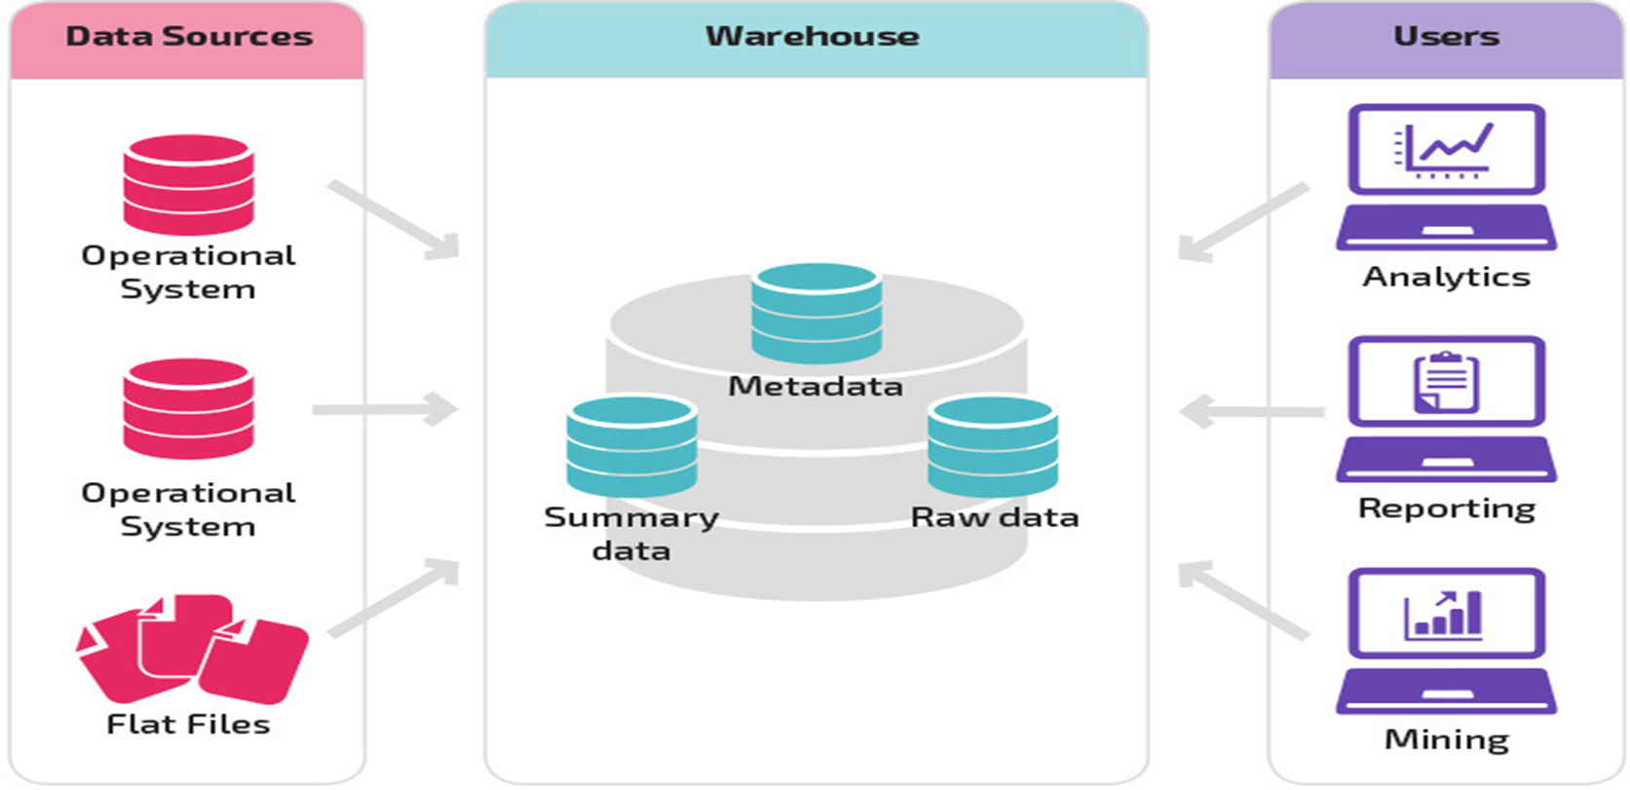
DATABASE DESIGN- DATAWAREHOUSE ARCHITECTURE

Slide 5
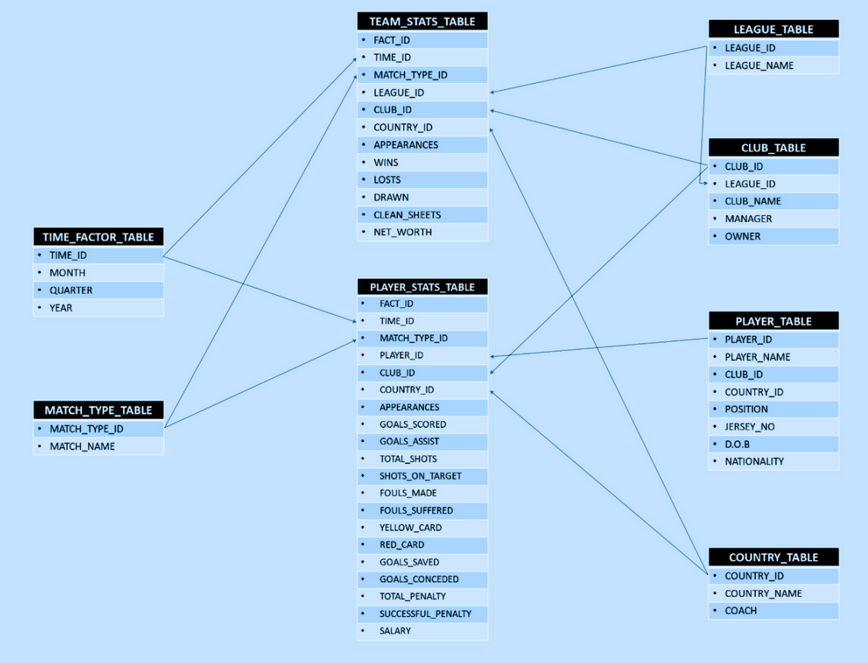
SCHEMA DESIGN- FACT CONSTELLATION SCHEMA

Slide 6
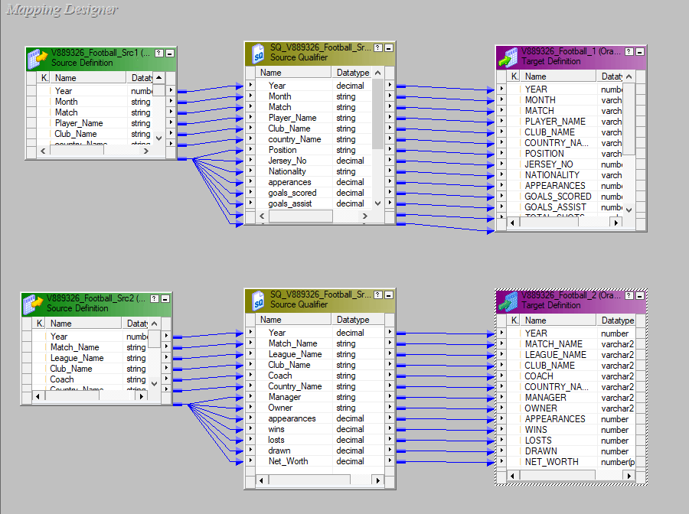
MAPPINGS:
DATA STAGING

Slide 7
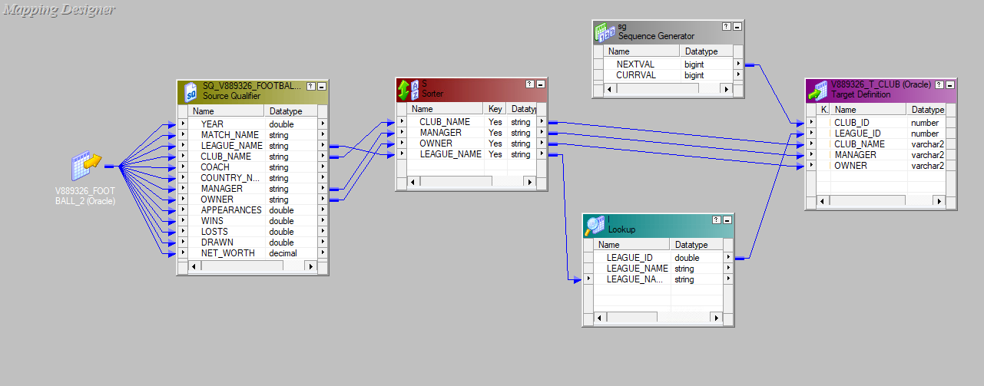
CLUB

Slide 8
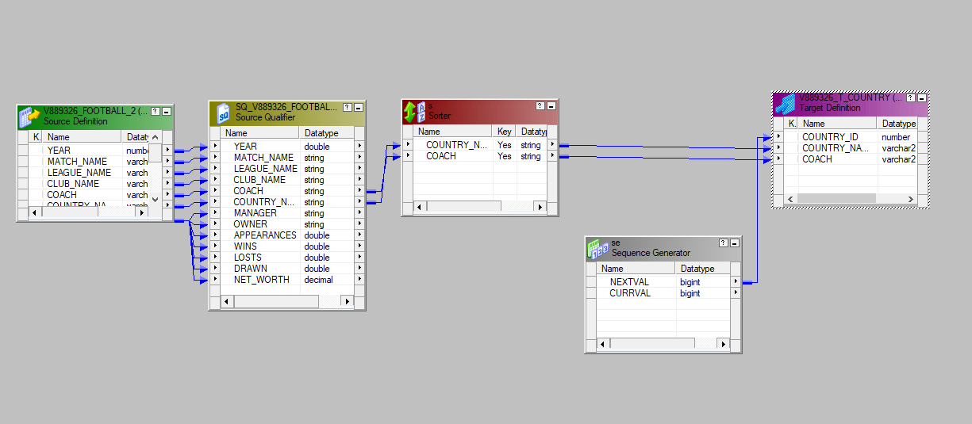
COUNTRY

Slide 9
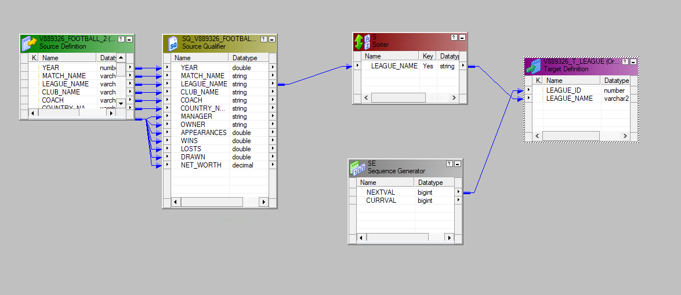
LEAGUE

Slide 10
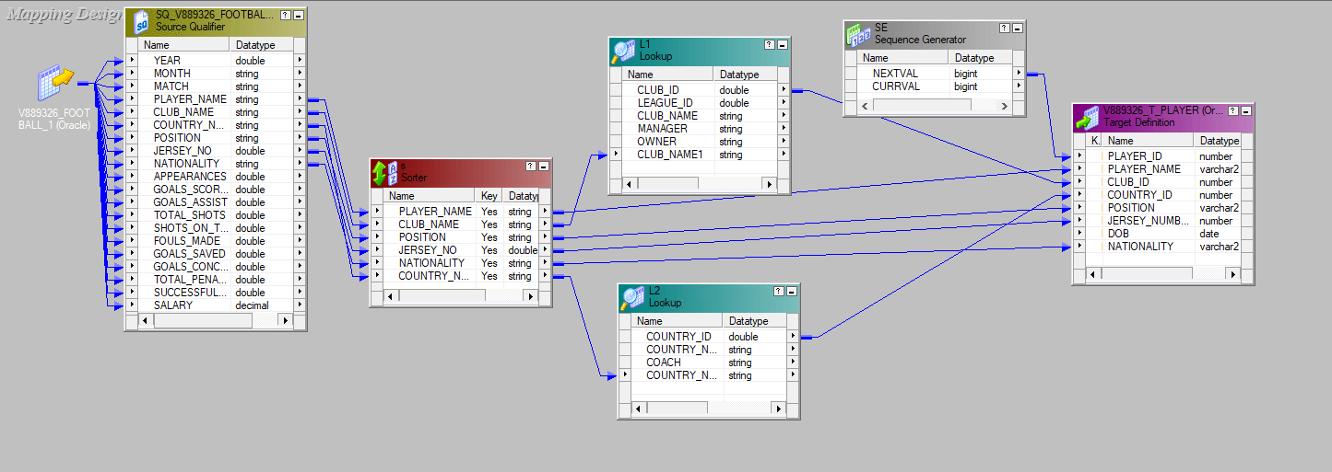
PLAYER

Slide 11
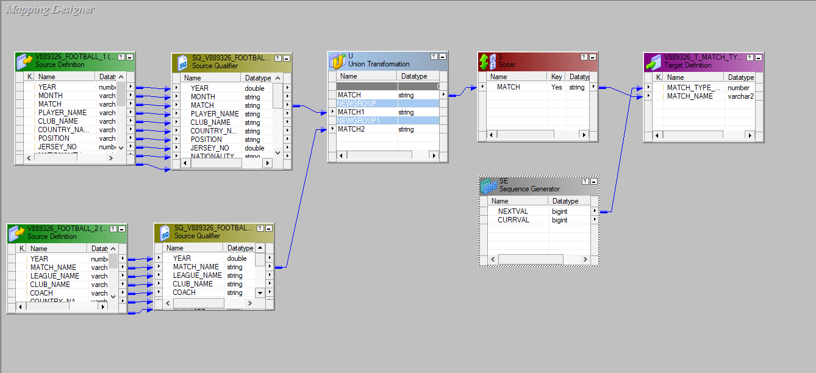
MATCH_TYPE

Slide 12
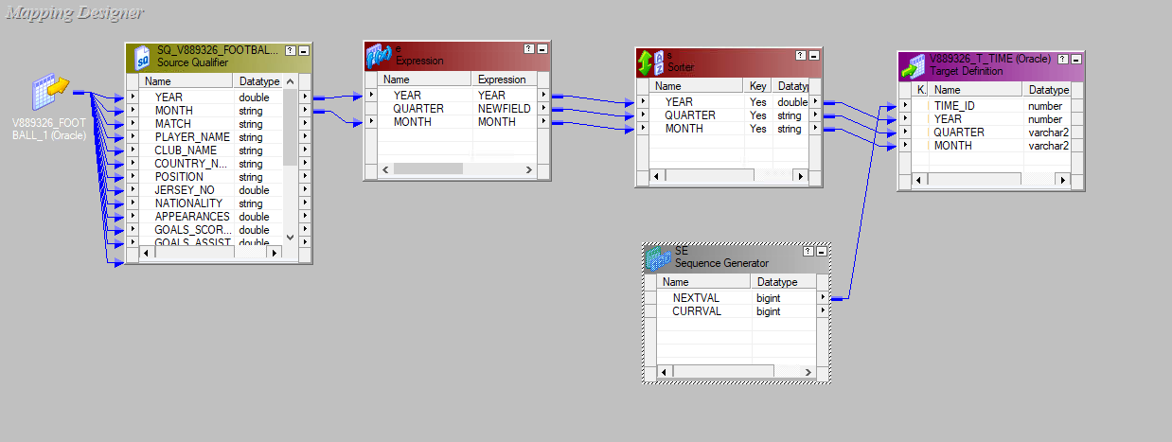
TIME

Slide 13
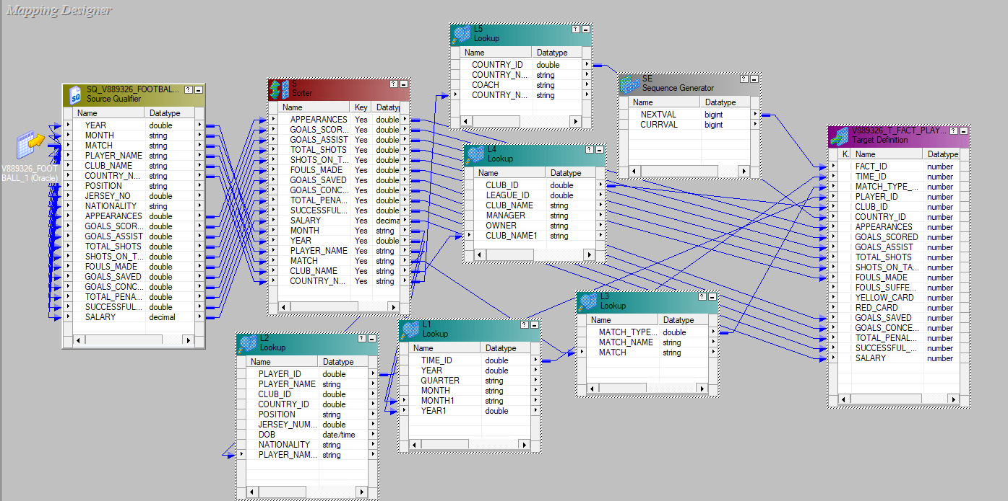
FACT PLAYER STATISTICS

Slide 14
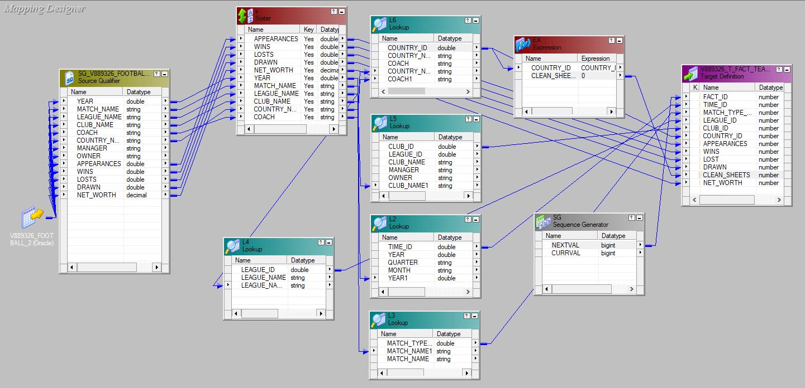
FACT TEAM STATISTICS

Slide 15
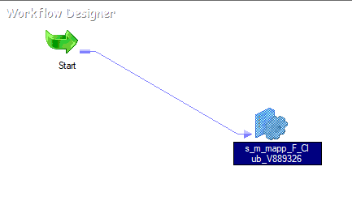
WORKFLOW

Slide 16
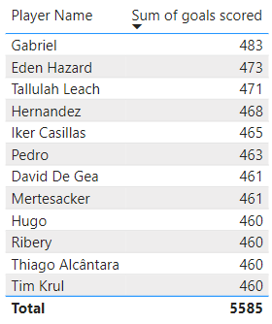
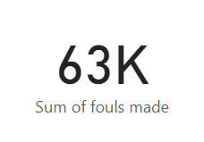
REPORTS
TOP 10 GOAL SCORERS:
TOTAL FOULS MADE:

Slide 17
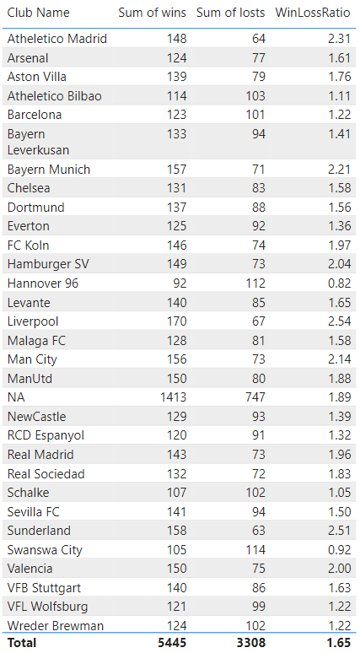
CLUB’S WIN/LOSS RATIO:

